Slide 1
Real-time Geometry Caches
Axel Gneiting | axel@crytek.com | SIGGRAPH 2014 | 13th August 2014

Slide 2
Motivation
Wanted next-gen visuals for Ryse
Lots of VFX set pieces
Art pipeline bottleneck (required baking to joints)
Needed simpler way to get animations into engine
Solution: Import Alembic
Notes:
Animations like cloth, water simulations, fur
Alembic: No engine specific markup. One click to import and run. Outsourcing much easier

Slide 3
Challenge
Massive data rate?
Naïve approach: 56 bytes per vertex (14 floats)
Position, UV, Normal, Tangent, Binormal, (Color)
Sail: 30000 vertices, 30 FPS ≈ 50MB/s
Ryse budget: 10MB/s
Notes:
More than Alembic actually, need full tangent frames
10 MB/s is for the whole scene, not only one cache

Slide 4
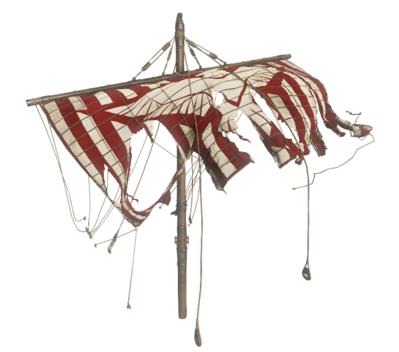
Compression Overview
50
Only transform for rigids
Vertex animation
Fewer bits per vertex
Transform data
Compression
Restriction: Only static topology
Data Rate (MB/s)
Notes:
Obviously we don‘t store per frame data for rigid / non-deforming meshes
Data rate is bar is always for the sail
Transform data to help compression
Data rate meter for specific sail asset with 30.000 vertices. Data rate meter will indicate progress
on data rate reduction during the methods presented in the talk.

Slide 5
Transforms
50
Simplify the tree
Transforms: Rotation + Translate + Scale
Data Rate (MB/s)
Notes:
Bake down static hierarchies
Bake down animated child of animated parent
No support for shear
Transforms: 40 instead of 48 bytes. Compared to vertex animations we can neglect this. We didn‘t optimize it a lot.

Slide 6
Fewer Bits (Quantization)
Positions: 3x uint16
Texture Coordinates: 2x int16
QTangents 4x 10 bits (int16) [FREY11]
(Colors: 4x 8 bits RGBA)
Only lossy step
16
Data Rate (MB/s)
Notes:
Positions defined in bbox space. mm accuracy for 64m mesh. Quantizer will use less bits if possible, artist can specify the mm precision he needs.
Texture coordinates get mapped to [-1024, 1024] which leaves enough fractional digits
Tangent frames mean only orthonormal tangent frames. Doesn‘t matter in practice for us. We use 16 bit shorts for 10 bit values because compressor works on bytes

Slide 7
Compression
Block compress each frame
Deflate (zlib) [DEUTSCH96] or LZ4 HC [COLLET13]
10
Data Rate (MB/s)
Notes:
Deflate is slow but pretty good compression
LZ4 HC is usally 20% worse compression, but 10x faster decode. Almost like memcpy.
Still 10MB/s for one asset, we need to do better

Slide 8
Prediction Overview
Predict utilizing temporal and spatial similarities
Store residuals (differences)
10
Data Rate (MB/s)
Notes:
Of course need to do same prediction at runtime than at compile time, otherwise don‘t get same result
Residual symbols cluster around zero, because prediction tends to be close. The more of the same symbols, the better the compression.

Slide 9
Predictor Requirements
Deterministic
In-place prediction
As fast as possible
10
Data Rate (MB/s)
Notes:
Always needs to predict exactly the same way (obvious)
No extra memory allocations on decode
Needs to decode in real time

Slide 10
Intra Prediction (i Frames)
Predict positions from adjacent tris [ISENBURG02]
...
8,5
Data Rate (MB/s)
Notes:
Parallelogram prediction. Extend adjacent triangles to parallelograms.
Blue: Last triangle(s) Orange: Parallelogram prediction Black arrow: Residual to store
Can do this in place: for each vertex predict, read, add, write
Also used for UVs
QTangents just use average of last two vertices, because parallelogram rule makes no sense for them
Savings depend on asset

Slide 11
Intra Prediction (I Frames)
Adjacent tri must be decoded
Need to reorder vertices
First run vertex cache optimizer
Sort vertices by first use in index buffer
Per vertex search for best prev vertices
Store offsets for decode
8,5
Data Rate (MB/s)
Notes:
Optimizer tends to order indices so mesh gets rendered in strips
Offset only needs to be stored in file header, because we only support non-changing topology

Slide 12
Inter Prediction (B Frames)
Full (index) frame data only every n frames
B frames predicted using temporal similarities
8,5
Data Rate (MB/s)
Notes:
For us optimal index frame distance was about 10

Slide 13
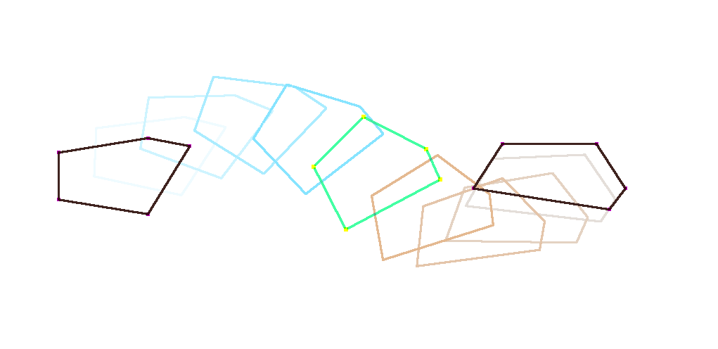
Inter Prediction (B Frames)
8,5
Data Rate (MB/s)
Notes:
Original motion

Slide 14
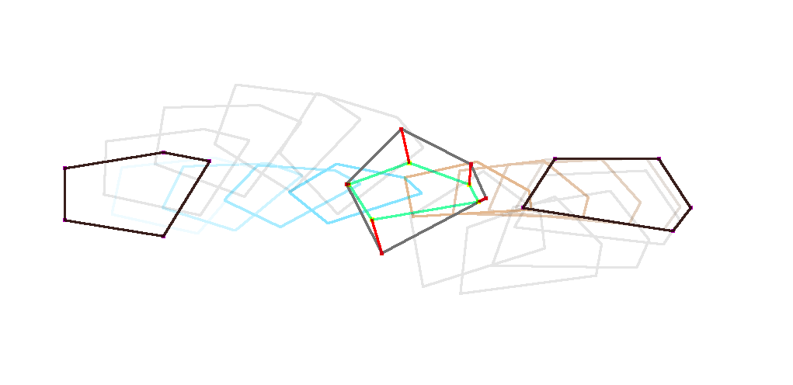
Inter Prediction (B Frames)
8,5
Data Rate (MB/s)
Notes:
Interpolated prediction

Slide 15
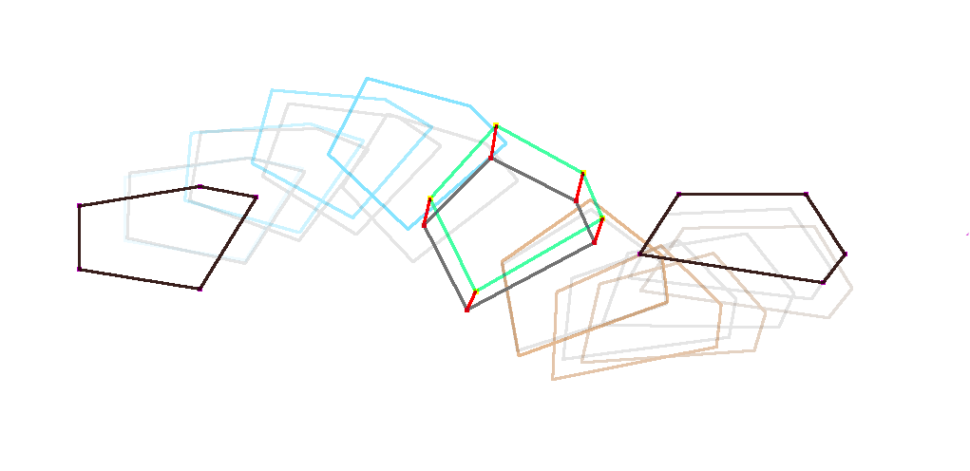
Inter Prediction (B Frames)
8,5
Data Rate (MB/s)
Notes:
Motion prediction

Slide 16
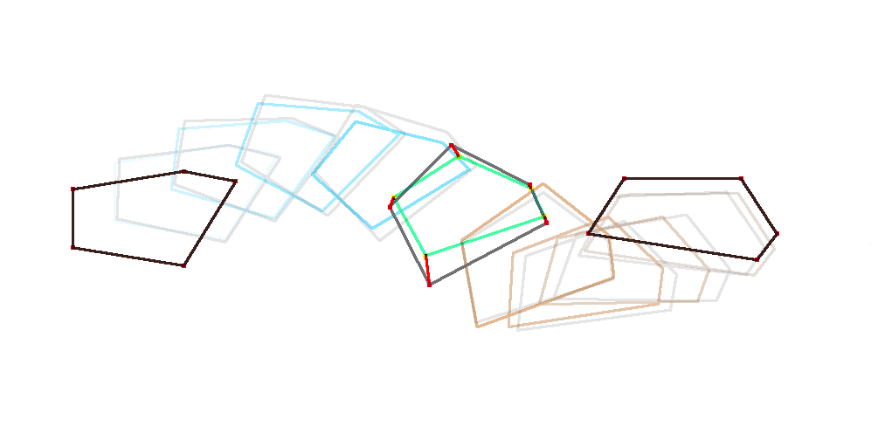
Inter Prediction (B Frames)
8,5
Data Rate (MB/s)
Notes:
Combination of motion and interpolation prediction

Slide 17
Inter Prediction (B Frames)
I_{n+1}
I_{n}
B
t
8,5
Data Rate (MB/s)
Notes:
Select interpolation factor for interpolation

Slide 18
Inter Prediction (B Frames)
I_{n+1}
F_{p}
I_{n}
F_{pp}
B
t
8,5
Data Rate (MB/s)
Notes:
Select acceleration factor for motion

Slide 19
Inter Prediction (B Frames)
I_{n+1}
I_{n}
B
t
8,5
Data Rate (MB/s)
Notes:
Select extrapolation factor for combination
The three factors used are the same for all vertices in mesh, so individual predictions will usually be worse than here.

Slide 20
Inter Prediction (B Frames)
Binary search residual entropy for factors
Three bytes extra / mesh / frame
Can also do this in place
Vectorizable (SIMD)
Much better prediction than intra
4,5
Data Rate (MB/s)
Notes:
Factors get quantized to three bytes per frame for all vertices
Can use SIMD for this to predict 4 elements in parallel (some INT16 operations even on 8 elements)
Just unpack 8xINT32 -> 2x4xUINT32, mul, shift, truncate & pack again on Jaguar per interpolate/extrapolate

Slide 21
Playback Overview
Needs to run in real-time
Streaming
Parallelization
Notes:
Loading time would also be a problem
Next gen CPU cores still not terribly fast

Slide 22
Streaming Data Flow And TimingS
Disk
Buffer
GPU
t = -5s
Read
t = 0
Convert
t = -0.5s
Decompress/Decode
Notes:
Disk reads and decompress/decode are asynchronous and non-blocking
Read combining to avoid disk seeks (>1 MB chunks)
Upload to GPU is asynchronous but render thread will wait for data
Data in buffer stays in compact disk format until decompress starts
Timings are configurable, values were choosen by experimentation

Slide 23
Buffering
Experimented with ring allocator
Problems with multiple streams
Used dedicated heap instead
dlmalloc based
Notes:
Ring buffer allocator doesn‘t work for multiple streams, because of different data rates. Would need to defragment holes. Really tried to make this work, but wasn‘t worth it in the end.
Fragmentation with normal allocator wasn‘t a big problem
128 MB for both compressed and uncompressed data

Slide 24
Parallel Decompress & Decode
Compressed
Compressed
Decompressed
Decompressed
...
I
I
B
B
B
B
B
B
B
B
I
I
Notes:
Jobs for decompression
Index frame jobs can start as soon as decompressed data is ready

Slide 25
Parallel Decompress & Decode
Compressed
Compressed
Decompressed
Decompressed
...
I
I
B
B
B
B
B
B
B
B
B
I
I
Notes:
First B frame has I frames and own residuals as input (First B frame does not do acceleration prediction)

Slide 26
Parallel Decompress & Decode
Compressed
Compressed
Decompressed
Decompressed
...
I
I
B
B
B
B
B
B
B
B
B
B
I
I
Notes:
Other B frames have only last B frame and residuals as dependencies, because by induction both I frames and the last two B frames are decoded
All other B-frames depend on previous one as well
We do the synchronization for all jobs with lockless atomic counting:
I frames get initialized to 1, first B frame after I frame to 3, all other B frames to 2
After dependency is finished will decrease counter of dependent task and launch it when counter reaches 0

Slide 27
Rendering
Job for GPU convert & upload
SIMD
Motion vectors & transforms update
Interpolates between frames
Instancing for rigids
Notes:
The conversion job gets launched for each job the geom cache actually gets rendered
Conversion job could possibly be avoided if GPU would directly read quantized format
The vertex shader could possibly directly support the quantized format

Slide 28
Future development
Support for changing topology
Improve compression
Better predictors
Better block compression
Automatic skinning
Support for physics
Tricky with vertex animation
Notes:
All of the compression research tends to lead to require more and more computational power for little gains
Automatic skinning would be a way to do more lossy compression

Slide 29
Special Thanks
Sascha Herfort, Nicolas Schulz, Bogdan Coroi, Theodor Mader, Carsten Wenzel, Chris Raine, Chris Bolte & Ivo Zoltan Frey
The entire Ryse team and Crytek

Slide 30
References
[DEUTSCH96] DEFLATE compressed data format specification version 1.3.
[COLLET13] Collet, Yann. "LZ4: Extremely fast compression algorithm.“
https://code.google.com/p/lz4/
[FREY11] Frey, Ivo Zoltan, and Ivo Herzeg. "Spherical skinning with dual quaternions and QTangents." SIGGRAPH Talks. 2011.
[ISENBURG02] Isenburg, Martin, and Pierre Alliez. "Compressing polygon mesh geometry with parallelogram prediction." Visualization, 2002

